Slide 1

SCET-MITWPU Title of Project- Design and Implementation of Visible Light Communication Transceiver Pair Domain of Project- AI, Visual light communication and IOT In-House Project
Names of Students with ERP nos.-
1032201938 Yash Bhavsar
1032202170 Shreyash Sontakke
1032202223 Yuvraj Khedekar
1032202209 Mrunal Dande
Name of BTech Capstone Project Guide- Dr. Sanket Salvi

Slide 2
Contents
Introduction
Motivation
Literature Survey
Problem Statement
Requirement Gathering
System Design
Future Aspects
Literature Review
References

Slide 3
Introduction
A key element of display-based optical camera communication is pattern recognition. Each pattern demands significant processing resources to decode. A growing number of Internet of Things (IoT) areas are interested in using optical camera communication (OCC) to offer non-radio frequency-based communication solutions. This OCC system is based on quantum chromodynamics (QCD) concepts and can provide user-centric multiple-input multiple-output (MIMO) capabilities. In order to obtain longer communication distance and effective pattern classification, Quantum Chromodynamics Inspired 2D Multicolor LED Matrix to Camera Communication. Using nested outer and inner patterns, custom patterns are created at the transmitter based on input data. For quicker decoding on the receiver side, inner and outer patterns are subjected to multi-threaded pattern matching simultaneously. The steps involved are encoding the bit pattern and decoding the same.

Slide 4
Motivation
The motivation behind using a Raspberry Pi as a Li-Fi LED transmitter is to explore and implement a cost-effective and versatile solution for wireless data communication. Li-Fi (Light Fidelity) technology leverages visible light to transmit data, offering several advantages:
1. High Data Rates: Li-Fi can achieve significantly higher data transfer speeds compared to traditional Wi-Fi, making it suitable for applications where fast data transmission is crucial.
2. Security: Li-Fi is more secure since it's confined to the area illuminated by the LED, reducing the risk of eavesdropping compared to radio waves.
3. Energy Efficiency: LED lights are energy-efficient, making Li-Fi a green technology. It aligns with the growing emphasis on energy conservation.
4. Infrastructure Utilization: Li-Fi can use existing LED lighting infrastructure, reducing the need for additional hardware.
5. Interference-Free: Li-Fi operates in the visible light spectrum, which is generally free from interference, making it a valuable option in environments with high radio frequency interference.
By using a Raspberry Pi as the control unit for the Li-Fi LED transmitter, developers and hobbyists can experiment with and implement Li-Fi technology in various applications, such as smart homes, indoor navigation, secure communication, and more, in a flexible and accessible manner.

Slide 5
Literature Survey
We examine the importance and possibilities of this innovative technology. This method entails creating a 2D multicolor LED matrix that uses user-centric MIMO (Multiple-Input, Multiple-Output) principles to connect with a camera.
The 2D matrix, which is made up of different coloured LEDs, enables data to be transmitted simultaneously, greatly improving data speeds and dependability.
User-centric MIMO offers an interactive and effective method of information exchange by customizing the communication experience to match the unique requirements and expectations of the end user.
The system's design gains a distinctive dimension from the incorporation of quantum chromodynamics-inspired methodologies, which tackles the advantages and disadvantages of this innovative method of optical communication.
In order to shed light on the exciting future potential in this field, this literature review explores the history, implications, and future prospects of this technology. It also covers its architecture, hardware and software requirements, alignment, calibration, security measures, performance, and user-centric applications.

Slide 6
Problem Statement
Design and implementation of Visible Light Communication Transceiver Pair using RPi, Camera and 8x8 LED matrix
A key element of display-based optical camera communication is pattern recognition. This OCC system is based on quantum chromodynamics (QCD) concepts and can provide user-centric multiple-input multiple-output (MIMO) capabilities.

Slide 7
Requirements Gathering
The H/w & S/w Requirements are as follows:
Hardware:
2 x Raspberry Pi
2 x 8*8 Light emitting diode (LED)
2 x Raspberry Pi Camera
Software:
Python
OpenCV
Putty

Slide 8
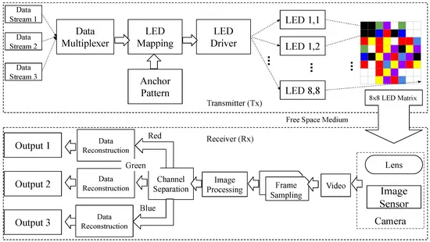
System Design
Show the System Architecture:

Slide 9
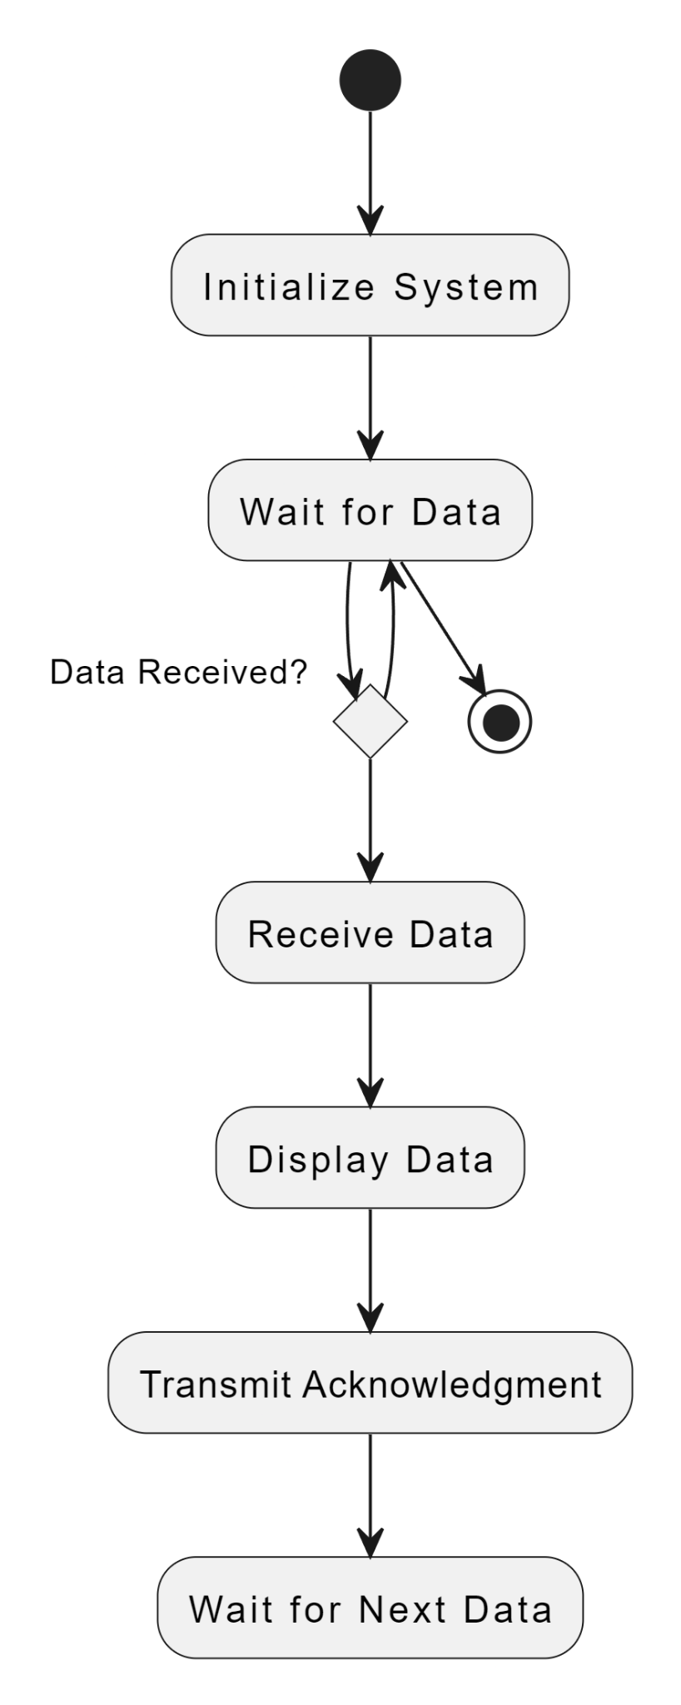
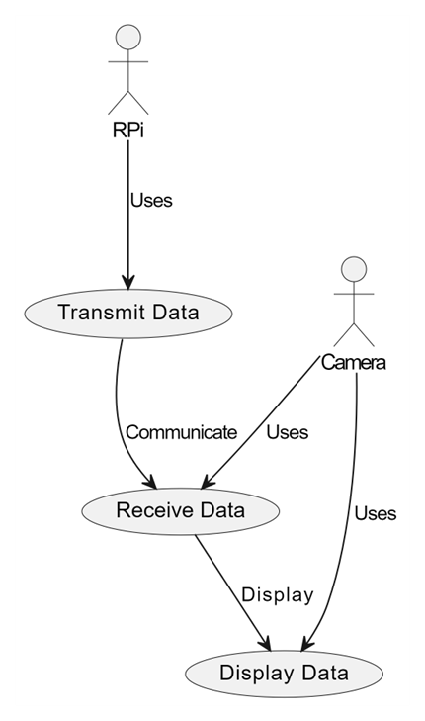
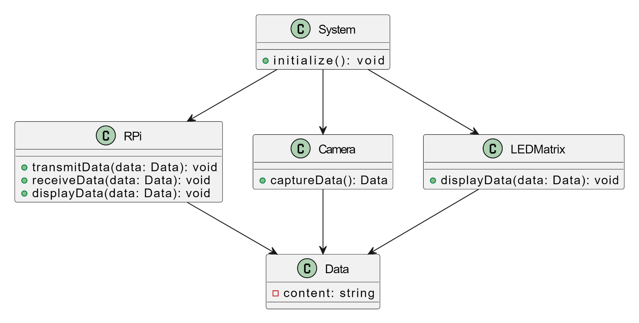
Class Diagram
Use case
Activity Diagram

Slide 10
Implementation and Testing
It is imperative to test every component separately and then integrate them all together. Check the accuracy of QCD simulations by contrasting the outcomes with well-established models. Test the data transmission rates, dependability, and resilience to interference for the VLC transceiver.
Procedure for Taking on the Project-
Planning and Research- Recognise the theoretical foundations of VLC, QCD, and pertinent AI methods. Arrange the necessary software and hardware.
Implementation- Write codes for IoT connectivity, VLC transceiver pairs, camera integration, AI algorithms, and QCD simulations.
Testing- Verify the efficiency, accuracy, and functioning of each module. Test the system as a whole and integrate its component parts.
Optimisation and Refinement: Enhance performance, optimise code, and refine the system.
Documentation- Record every step of the procedure, including the code, schematics, and final product.

Slide 11
Programming and Ethics
Programming Aspects:
Here are key programming aspects for the development of the communication system:
Signal Modulation Algorithms: Implement algorithms for encoding and decoding data using light properties such as intensity, frequency, and color variation inspired by Quantum Chromodynamics principles.
Image Processing Algorithms: Develop algorithms to extract and process signals from captured frames, facilitating data demodulation and reconstruction from the camera feed.
LED Matrix Control: Create software for controlling the 2D Multicolor LED Matrix, including algorithms for pattern generation, color variation, and intensity modulation.
MIMO Algorithm Implementation: Design and implement algorithms for Multiple Input Multiple Output strategies, optimizing data transmission between the LED matrix and the camera.
Simulation and Modeling Tools: Utilize programming languages (such as Python, MATLAB) to simulate and model system behavior, aiding in system design, optimization, and validation.
Error Correction and Optimization Algorithms: Develop algorithms for error correction and system optimization to enhance data transfer rates and reliability.

Slide 12
Ethical Considerations-
Here are five key ethics considerations for the development of the communication system:
Privacy and Data Security: Ensure that the system design prioritizes user data privacy. Implement robust encryption methods and data security protocols to safeguard sensitive information transmitted through the system.
User Consent and Transparency: Prioritize user consent and transparency regarding the system's functionality and data collection. Clearly communicate to users how their data is utilized within the system and obtain explicit consent for its use.
Accessibility and Inclusivity: Design the system considering accessibility standards to ensure inclusivity for users with diverse abilities. Ensure interfaces and controls are user-friendly and accessible to all potential users.
Environmental Impact: Assess and minimize the environmental impact of the system's components and operation. Consider sustainable materials, energy efficiency, and proper disposal practices for system components.
Ethical Use and Bias Mitigation: Mitigate biases in the system's algorithms or functionalities that might lead to unfair discrimination or misinformation. Ensure ethical use of the technology and regularly assess and address any biases that might arise.

Slide 13
Implementation of Project [ Algorithms,Techniques and Technologies used in detail ]

Slide 14
Testing Strategies used

Slide 15
Source code - Programming style,strategies used and its ethics

Slide 16
Deployment Strategies

Slide 17
Security Aspects and Project Maintenance
Security Aspects:
Data Encryption: Implement robust encryption techniques for data transmitted between devices, especially in IoT communication and VLC data transfer, to prevent unauthorized access.
Access Control: Employ authentication mechanisms to control access to the system components, restricting unauthorized users from interacting with critical parts of the system.
Secure Communication Protocols: Ensure that secure protocols (like TLS/SSL) are utilized for data transmission, especially in IoT connectivity between devices and cloud servers.
Vulnerability Assessment: Regularly perform security assessments to identify and mitigate vulnerabilities in software, firmware, or network configurations.
Privacy Considerations: Adhere to privacy regulations and ethical guidelines, especially regarding data collected by the RPi Cam or transmitted via the system.

Slide 18
Project Maintenance:
Regular Updates: Stay updated with software/firmware patches, libraries, and dependencies used in the project to address security vulnerabilities and improve performance.
Documentation: Maintain comprehensive documentation detailing system architecture, configurations, algorithms used, and any updates or changes made during the project lifecycle.
Monitoring and Logging: Implement monitoring systems to track system behavior, errors, and performance metrics. Maintain logs for troubleshooting and identifying potential issues.
Backup and Recovery: Establish regular backups of critical data and configuration settings. Implement recovery mechanisms to restore the system in case of failure.
Scalability and Adaptability: Design the system to be scalable and adaptable to future changes or enhancements, ensuring it can accommodate future upgrades or expansions.
Training and Knowledge Transfer: Ensure knowledge transfer among team members and document best practices to facilitate continuity in case of personnel changes.

Slide 19
Future Aspects
Explain the plan of next steps towards project completion.
To think about as future steps are these:
System Development and Prototyping: Using the design and architecture you've described, start by creating a functional prototype of the 2D multicolor LED matrix and camera communication system. Development of hardware and software will be required for this.
Testing and Validation: To verify the functionality of the system, thoroughly test the prototype. Check the latency, signal quality, and data transmission speeds. Find and fix any problems or places that need work.
Alignment and Calibration: To guarantee the system performs at its best, adjust the alignment and calibration processes. This could entail changing the settings for the hardware or software.
Security Implementation: To safeguard data sent through the LED matrix, put strong security procedures in place. Mechanisms for access control, authentication, and encryption ought to be combined.
Performance Optimization: Make constant efforts to improve the system's performance, paying particular attention to error correction algorithms, modulation strategies, and data encoding techniques. Find the bottlenecks and deal with them.

Slide 20
Individual Work
Individual Aim:
Student 1: Integration Optimisation Specialist Goal: Enhance the integration between a pair of visible light communication (VLC) transceivers and quantum chromodynamics (QCD) simulations running on a Raspberry Pi.
Goal: Using optimised VLC integration, improve the data transfer and reception efficiency for simulations linked to QCD.
Student 2: Expert in AI Data Analysis Goal: Create and optimise AI algorithms for in-the-moment data reception and transmission using the VLC transceiver pair.
Goal: Within the VLC framework, enable precise data processing and pattern identification that is specifically designed for data linked to QCD.

Slide 21
3. Student 3: IoT Security and networking Expert Goal: Create and put into practise reliable IoT networking protocols to provide smooth interaction between the Raspberry Pi, VLC transceiver, and outside systems.
Goal: Guarantee safe and effective data transfer while preserving compatibility across AI, VLC, and IoT elements.
4. Student 4: Research Lead and Documentation Coordinator Objective: Gather and compile research papers and documentation on AI, VLC, IoT, and QCD for thorough project documentation.
Goal: Put together a comprehensive report that includes the main results of the research, the methods used, and the specifics of the implementation for the project's presentations and documentation.
Each person's objective contributes to the broader aims while concentrating on a particular facet of the project. This strategy enables each team member to focus intently on their specialty, resulting in a well-rounded and cooperative effort.

Slide 22
Individual Objective:
To integrate AI capabilities into the system while optimising and implementing a safe and effective data transmission protocol between the Raspberry Pi, Raspberry Pi Camera (RPi Cam), and the Visible Light Communication (VLC) transceiver pair in Quantum Chromodynamics (QCD) simulations.
More information:
Optimisation of Data Transmission- Pay attention to enhancing the dependability and speed of data transfer between the VLC transceiver pair and the QCD simulations that are operating on the Raspberry Pi.
Secure Communication Protocol- To guarantee the confidentiality and integrity of data transferred between devices, implement strong encryption and secure protocols.

Slide 23
3. Integration of AI Capabilities- Investigate and include AI algorithms into the system to handle data sent over VLC, improving the examination of QCD-related data that the Raspberry Pi Camera has recorded.
4. Reporting and Documentation- Carefully record the implementation process so that it can be used in research papers, presentations, and project documentation.
In order to preserve synergy between the QCD simulations, Raspberry Pi, RPi Cam, VLC transceiver, AI integration, and Internet of Things parts of the project, this target coordinates each student's efforts towards guaranteeing efficient, secure, and intelligent data transfer. Moreover, it makes thorough reporting and documentation easier, both of which are necessary components of the project deliverables.

Slide 24
Individual Contribution with Module Design-
1. Student 1: QCD Simulation Module Design
Contribution: Design and implementation of the QCD simulation module on Raspberry Pi.
Responsibilities:
Developing the codebase for QCD simulations, ensuring compatibility with Raspberry Pi's architecture and optimizing performance.
Creating a user-friendly interface (if applicable) for initiating and controlling QCD simulations.
2. Student 2: Raspberry Pi Camera Integration Module Design
Contribution: Design and implementation of the Raspberry Pi Camera (RPi Cam) integration module.
Responsibilities:
Developing code for RPi Cam interaction, including capturing, processing, and potentially analyzing images or videos obtained.
Designing an interface to synchronize RPi Cam operations with other system components.

Slide 25
3. Student 3: Visible Light Communication (VLC) Transceiver Module Design
Contribution: Design and implementation of the VLC transceiver pair module.
Responsibilities:
Developing firmware/software for the VLC transceiver, focusing on modulation, error handling, and signal processing.
Designing the communication protocols and interfaces for seamless data transmission.
4. Student 4: AI Integration Module Design
Contribution: Design and implementation of the AI integration module.
Responsibilities:
Developing AI algorithms for data analysis and processing, specifically tailored for QCD-related data received from the system.
Designing the interface to integrate AI capabilities within the overall system architecture.

Slide 26
Publication Details: Literature Review
Sr. No. | Publication Title with authors [ mention whether Journal or Conference paper] | Publication Year | Positive points of the Publication | Gaps in publication work
1. | LiCamIoT: An 8x8 LED Matrix Pattern to Camera Communication for LiFi-IoT Applications | 2022 | IoT systems based on visible light communication can offer inexpensive, short-range indoor connectivity, which helps to relieve spectrum saturation. This study proposes, implements, and evaluates an Internet of Things application based on optical camera communication. | Radio Frequency(RF) Saturation cannot be reduced if the distance between the communicating devices is more.
2. | A Novel 2D LED Matrix and Aztec Pattern Inspired Optical Camera Communication for Industrial IoT | 2022 | The purpose of this work is to give an alternative communication method without sacrificing the number of linked devices in a typical industrial setting. To that end, an optical camera communication system inspired by the Aztec design is proposed. | Congestion is brought on by the growing number of smart devices linked to the network, while spectrum saturation is the result of heavy use of radio frequency (RF)-based communication channels.

Slide 27
3. | A Nested Texture Inspired Novel Image Pattern Based Optical Camera Communication | 2022 | Giving an alternate communication mechanism without reducing the number of linked devices in an industrial context is the aim of this effort. In order to do this, a suggested optical camera communication system with Aztec design inspiration is presented. | IoT applications that require low data rate consumption and long-distance communication can employ under-sampled rolling shutter-based OCC or global shutter for communication.
4. | Quantum-Chromodynamics-Inspired 2D Multicolor LED Matrix to Camera Communication for User-Centric MIMO | 2022 | This work presents an OCC system that is loosely based on notions from quantum chromodynamics (QCD) that can enable user-centric multiple-input multiple-output (MIMO). | There aren't many natural phenomena that exhibit colour shifts directly related to alterations in their fundamental makeup.
5. | Optical Camera Communications for IoT-Rolling-Shutter Based MIMO Scheme with Grouped LED Array Transmitter | 2020 | A streamlined multi-channel transmitter (Tx) design is suggested for flicker-free transmission, utilising a 7.2 x 7.2 cm2 tiny 88 dispersed light emitting diode (LED) array based on grouping of LEDs. | The OCC data rate is restricted by the image sensors' (ISs) frame rate. However data rates can be increased by using higher frame rate cameras which is very costly gradually increasing the cost.

Slide 28
Future planning for Implementation Paper:
It presents a methodical way to move this idea from theory to practical implementation. The creation and prototyping of a working system are the next steps, which are then rigorously tested and validated to make sure the system satisfies performance standards.
Strict security measures will be put in place to protect sent data, and alignment and calibration procedures will be fine-tuned to optimize data transfer. Interactive applications and improved user interfaces will improve the user-centric experience.
Error correction, modulation, and data encoding techniques will continue to be the key priorities in performance optimization. We'll investigate how this technology integrates with the Internet of Things and smart surroundings, opening up new possibilities for automation and connectivity.
In order to guarantee conformity to industry standards, regulatory compliance will be handled. The system will be continuously tested and refined with user feedback, and transparency and knowledge sharing will be guaranteed by the project's reporting and documentation.
As the project moves forward, it will be crucial to assess results, efficiently manage resources and the budget, and deal with any new hazards that may arise. The project will be completed, with an assessment of the findings and possible directions for further study and advancement, at the end of the article.
With the potential to bring forth significant breakthroughs in optical communication, this comprehensive plan lays the groundwork for the successful application of this transformative technology.

Slide 29
References
https://doi.org/10.3390/app122010204
https://ieeexplore.ieee.org/stamp/stamp.jsp?arnumber=9915602
https://ieeexplore.ieee.org/abstract/document/10040141/
https://ieeexplore.ieee.org/abstract/document/10028869/
https://www.researchgate.net/publication/342170425_Optical_Camera_Communications_for_IoT-Rolling-Shutter_Based_MIMO_Scheme_with_Grouped_LED_Array_Transmitter
https://www.ijert.org/research/a-review-paper-on-li-fi-technology-IJERTCONV5IS23003.pdf?shem=iosie

Slide 30
Thank you !!

